Slide 1
Aerothermochemistry and Combustion
DAYS 11 and 12
Kumaresh
2024/06/03

Slide 2
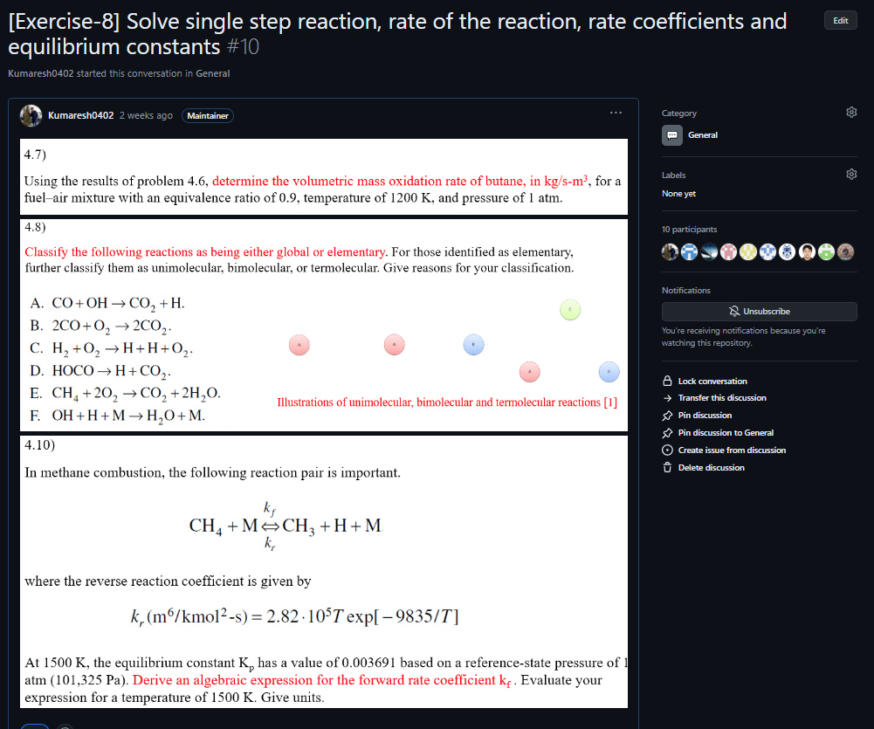
Quick Recap
Notes:
https://ezgif.com/maker
Dirichlet boundary conditions assume the solution to the variable.
In Neumann boundary conditions, a solution is assumed for the derivative of the variable.
https://en.wikipedia.org/wiki/Von_Neumann_stability_analysis

Slide 3
Contents
Solving Convection equation in OpenFOAM
Project – 2
Running combustion tutorials in OpenFOAMv2106
Project – 3
Creating a new OpenFOAM solver based on icoFoam by adding temperature field
Exercise – 9

Slide 5
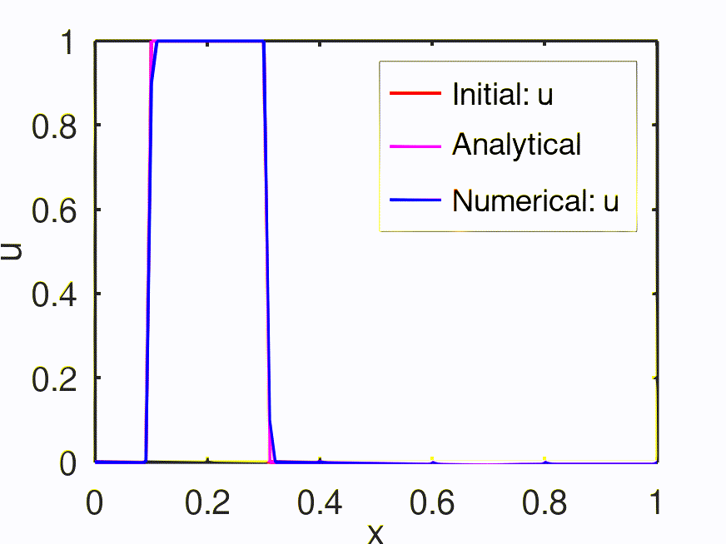
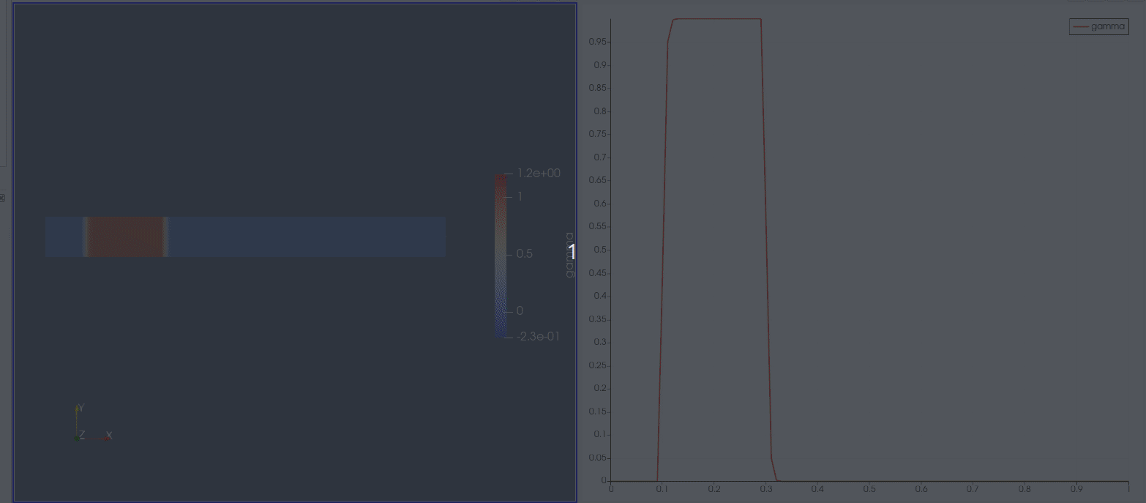
(1) OpenFOAM: Numerical Solution to Convection Equation
$$\frac{∂u}{∂t}+c\frac{∂u}{∂x}=0$$

Slide 6
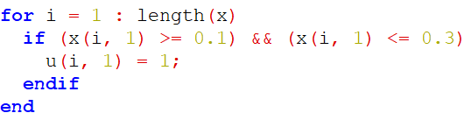
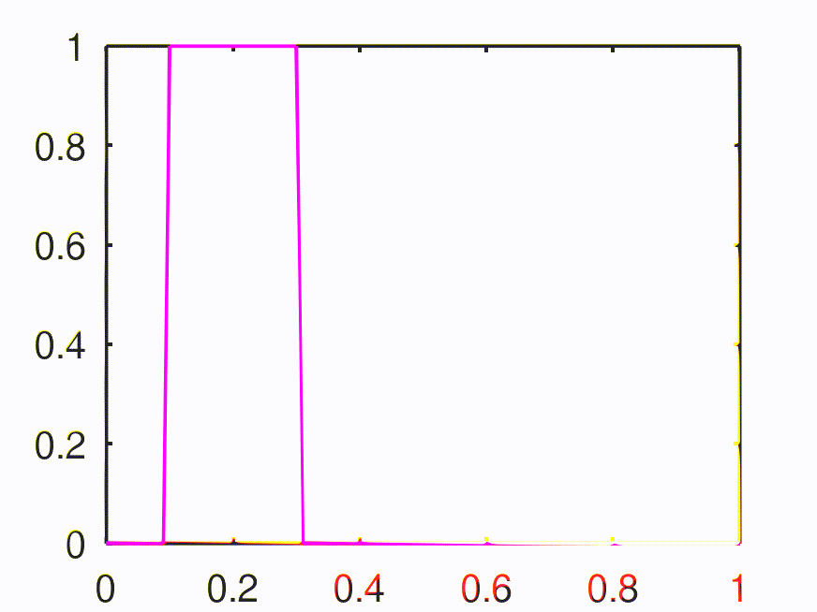
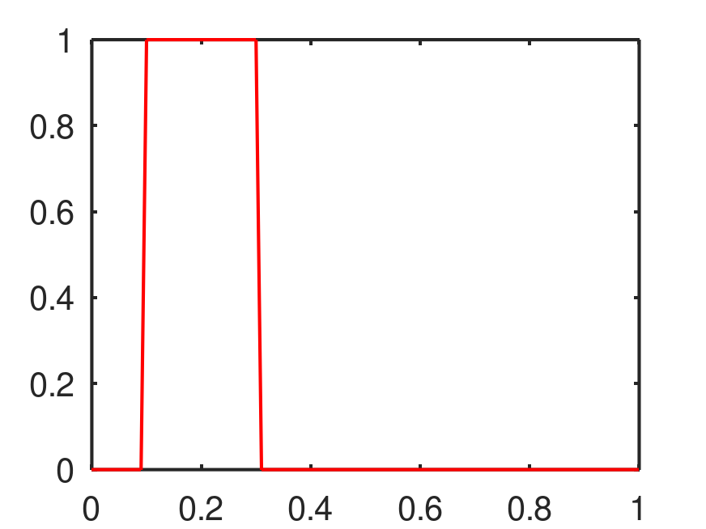
Convection Equation
Setting initial field
$$Velocity:c$$

Slide 7
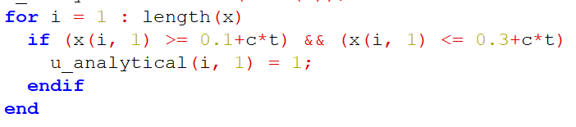
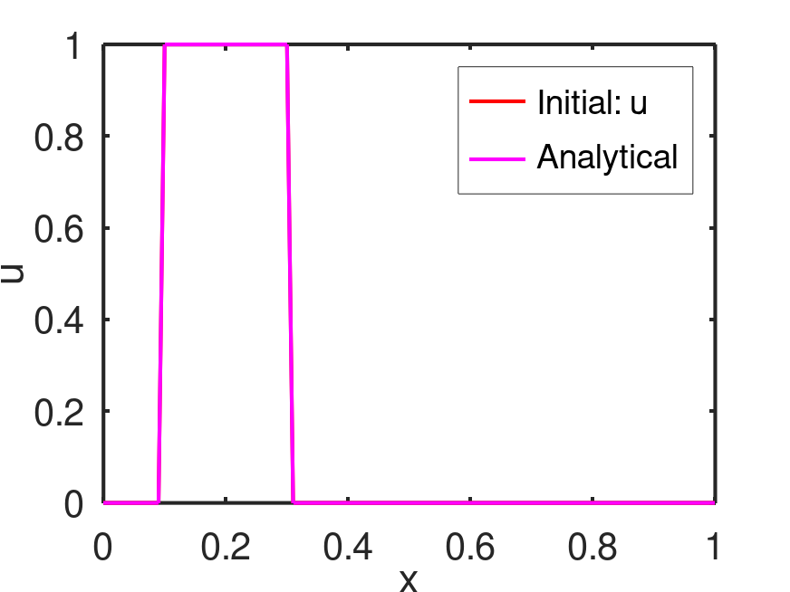
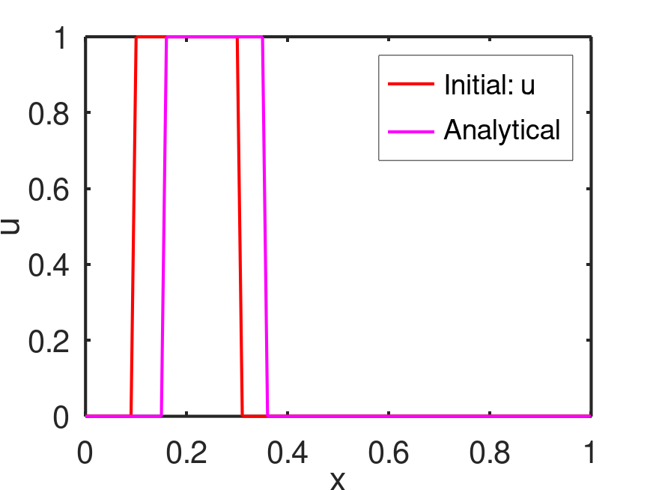
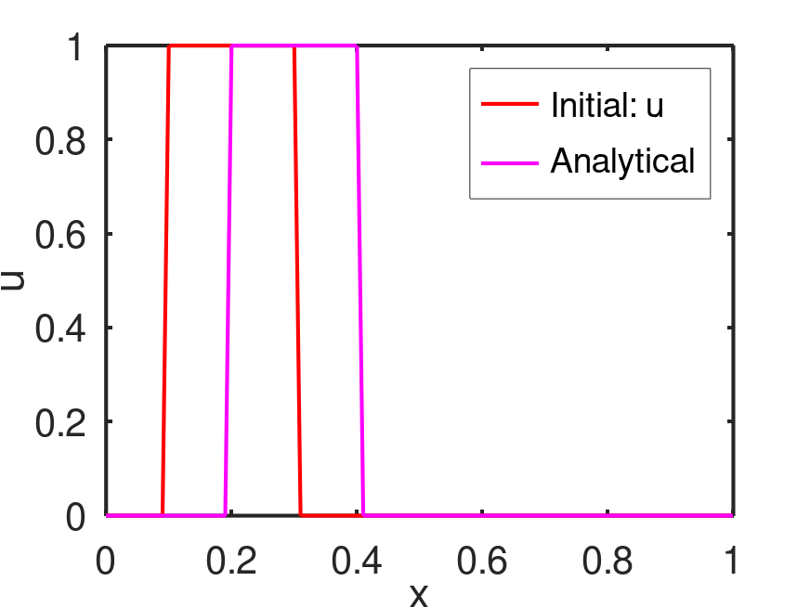
Convection Equation
$$\frac{∂u}{∂t}+c\frac{∂u}{∂x}=0$$
Advection equation

Slide 8
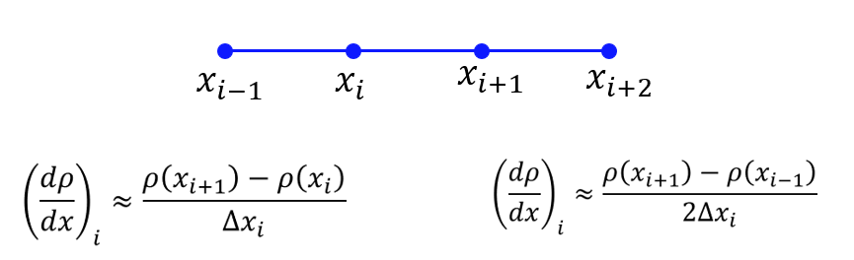
Convection Equation
$$\frac{∂u}{∂t}+c\frac{∂u}{∂x}=0$$
$$\frac{u_{i}^{n+1}−u_{i}^{n}}{Δt}+c{\left(\frac{∂u}{∂x}\right)}_{i}^{n}=0$$
$$x_{i−1}$$
$$x_{i}$$
$$x_{i+1}$$
$$x_{i+2}$$
$${\left(\frac{∂u}{∂x}\right)}_{i}^{n}≈\frac{u_{i+1}^{n}−u_{i}^{n}}{Δx_{i}}$$
Simple forward
difference scheme
$$u_{i}^{n+1}=u_{i}^{n}−cΔt{\left(\frac{∂u}{∂x}\right)}_{i}^{n}$$
$${\left(\frac{∂u}{∂x}\right)}_{i}^{n}≈\frac{u_{i+1}^{n}−u_{i−1}^{n}}{2Δx_{i}}$$
Central difference
(Explicit) First order - Forward Euler
(only one unknown (n+1) with other knowns at n^{th} node) → conditionally stable

Slide 9
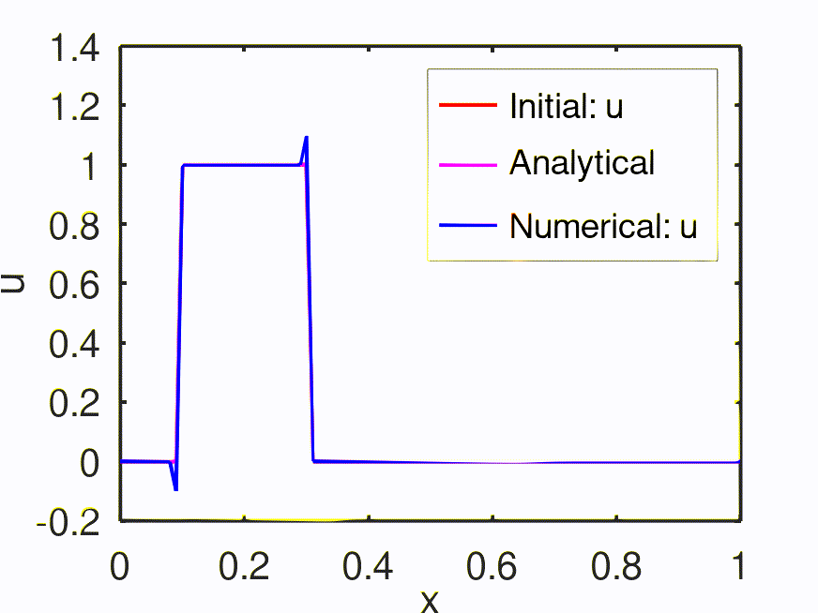
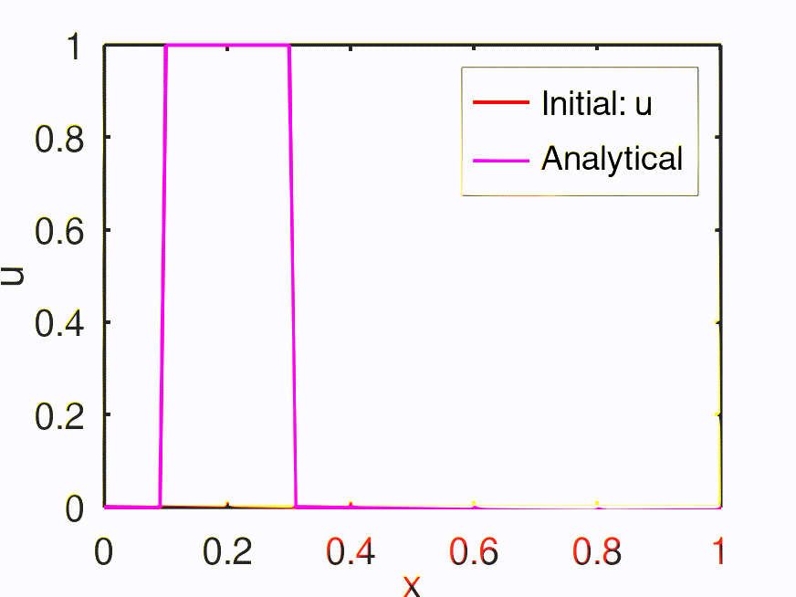
Convection Equation
Time level: $n+1$
$$x_{i−1}$$
$$x_{i}$$
$$x_{i+1}$$
$$x_{i+2}$$
Time level: $n$
$$x_{i+1}$$
$$x_{i+2}$$
$$x_{i−1}$$
$$x_{i}$$
Information from right to left end
$${\left(\frac{∂u}{∂x}\right)}_{i}^{n}≈\frac{u_{i+1}^{n}−u_{i}^{n}}{Δx_{i}}$$
Simple forward
difference scheme
$$u_{i}^{n+1}=u_{i}^{n}−cΔt{\left(\frac{∂u}{∂x}\right)}_{i}^{n}$$
$${\left(\frac{∂u}{∂x}\right)}_{i}^{n}≈\frac{u_{i+1}^{n}−u_{i−1}^{n}}{2Δx_{i}}$$
Central difference

Slide 10
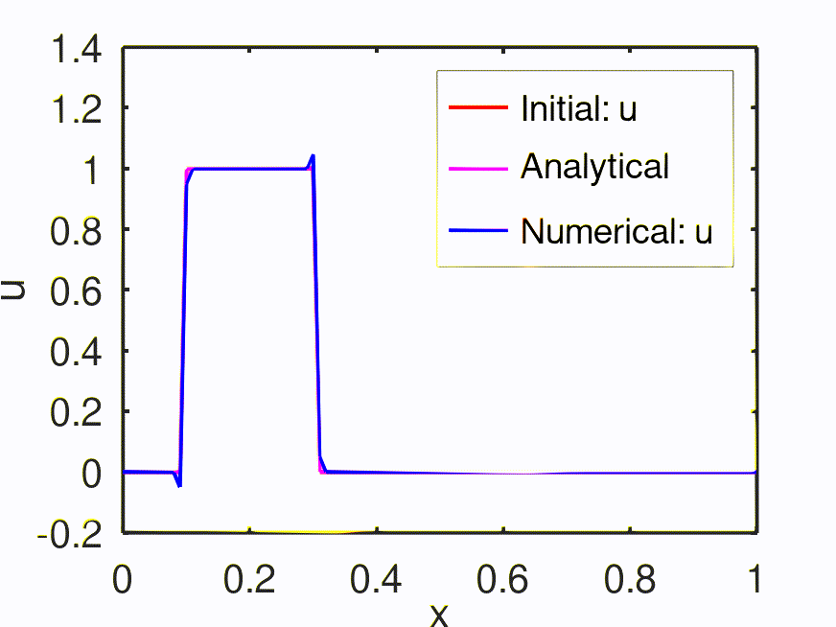
Convection Equation
Time level: $n+1$
$$x_{i−1}$$
$$x_{i}$$
$$x_{i+1}$$
$$x_{i+2}$$
Time level: $n$
$$x_{i+1}$$
$$x_{i+2}$$
$$x_{i−1}$$
$$x_{i}$$
Information from left and right ends
$${\left(\frac{∂u}{∂x}\right)}_{i}^{n}≈\frac{u_{i+1}^{n}−u_{i}^{n}}{Δx_{i}}$$
Simple forward
difference scheme
$$u_{i}^{n+1}=u_{i}^{n}−cΔt{\left(\frac{∂u}{∂x}\right)}_{i}^{n}$$
$${\left(\frac{∂u}{∂x}\right)}_{i}^{n}≈\frac{u_{i+1}^{n}−u_{i−1}^{n}}{2Δx_{i}}$$
Central difference

Slide 11
Convection Equation
Time level: $n+1$
$$x_{i−1}$$
$$x_{i}$$
$$x_{i+1}$$
$$x_{i+2}$$
Time level: $n$
$$x_{i+1}$$
$$x_{i+2}$$
$$x_{i−1}$$
$$x_{i}$$
Information from left to right end
$$u_{i}^{n+1}=u_{i}^{n}−cΔt{\left(\frac{∂u}{∂x}\right)}_{i}^{n}$$
$${\left(\frac{∂u}{∂x}\right)}_{i}^{n}≈\frac{u_{i}^{n}−u_{i−1}^{n}}{Δx_{i}}$$
Simple backward
difference scheme
$$CFL: \frac{cΔt}{Δx}$$
CFL < 1 → Numerically stable (conditionally stable based on the condition imposed by CFL) – EXPLICIT method
CFL > = 1 → Numerically unstable
CFL = 0.1

Slide 12
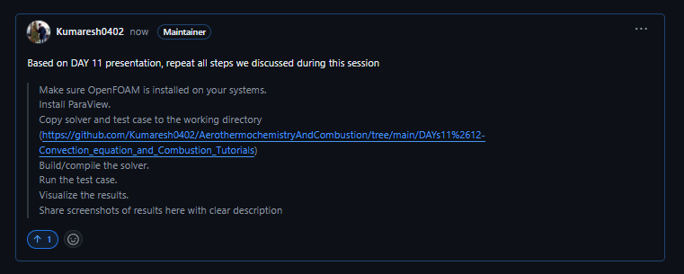
Project – 2 (Convection Equation using OpenFOAM)
$$\frac{∂u}{∂t}+c\frac{∂u}{∂x}=0$$

Slide 14
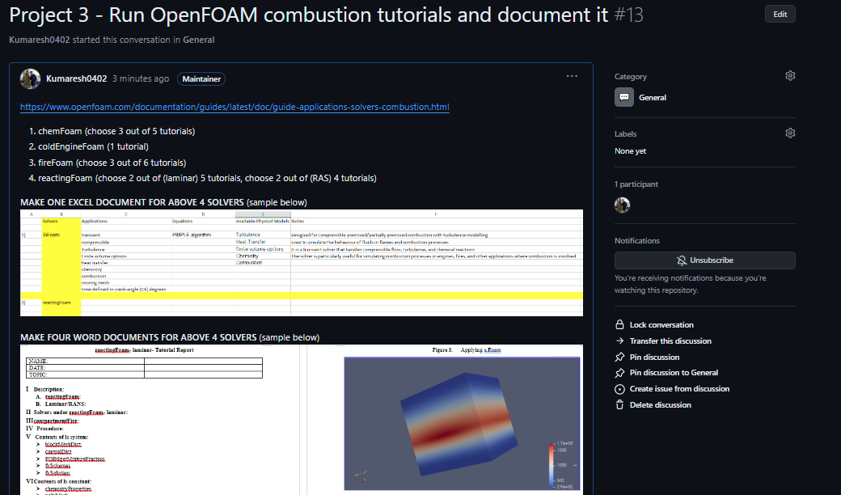
2. Run combustion tutorials in OpenFOAM and document it

Slide 16
3. Creating a new OpenFOAM solver based on icoFoam by adding temperature field
Copy default icoFoam solver
Adding the temperature field in the icoFoam solver
Copy default cavity tutorial based from icoFoam
Add a new file for initial and boundary conditions
Add respective files in fvSchemes and fvSolution
Run your new case file
Upload your new solver, case files, and results in GITHUB

Slide 17
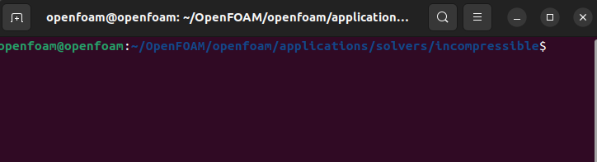
(i) Copy default icoFoam solver
From the location:
To make your own solver, firstly do the following:
Change the default icoFoam name into myIcoFoam.
Change the source file name from icoFoam.C into myIcoFoam.C
Open Files, and do the following:
myIcoFoam.C
EXE = $(FOAM_USER_APPBIN)/myIcoFoam

Slide 18
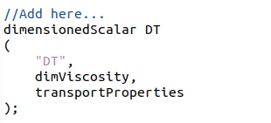
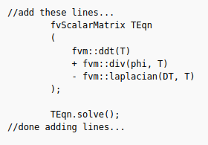
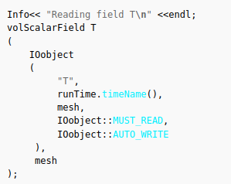
(ii) Adding the temperature field in the icoFoam solver
Under createFields.H
Under myIcoFoam.C

Slide 19
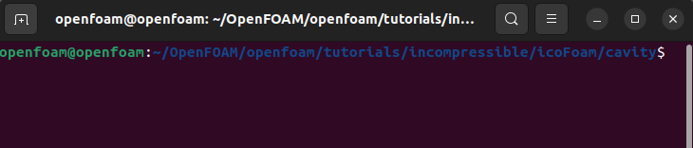
(iii) Copy default cavity tutorial based from icoFoam
From the location:
Modify your solver name as myCavityCaseFile

Slide 20
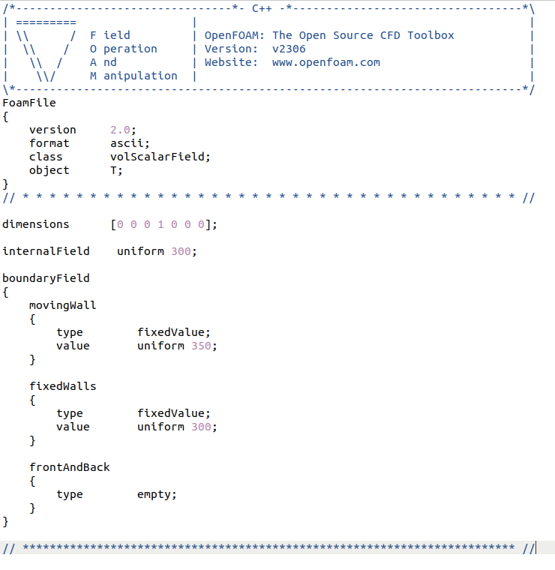
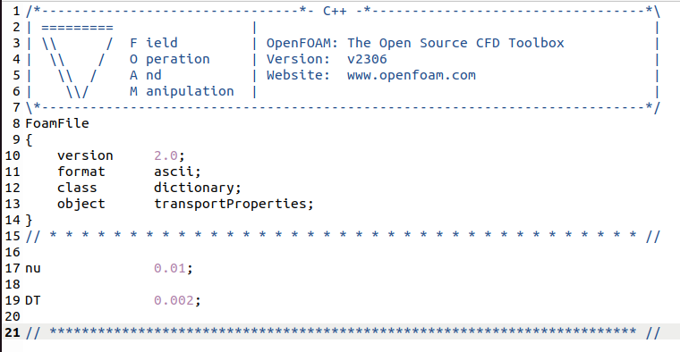
(iv) Add a new file for initial and boundary conditions
Under constant/transportProperties
Add DT (new variable created)
Add “T” field in “0” file

Slide 21
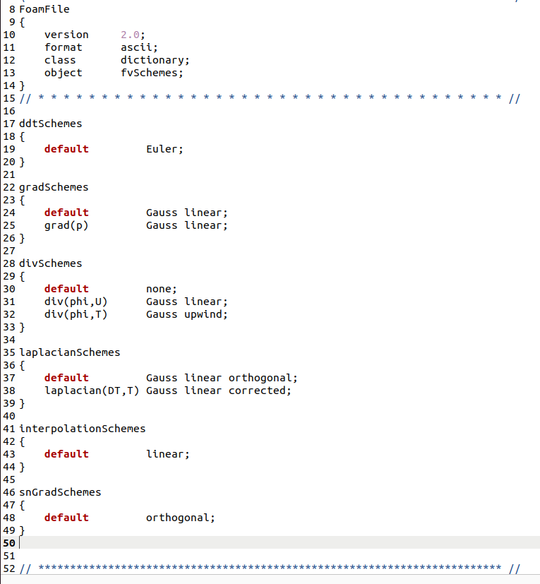
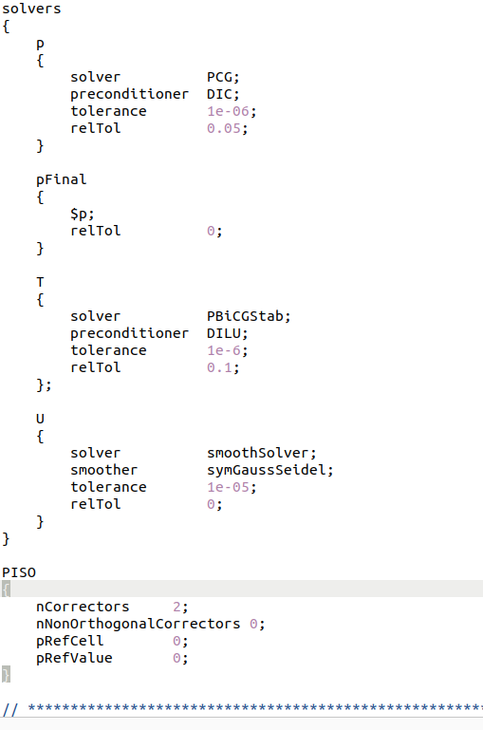
(v) Add respective files in fvSchemes and fvSolution
Under system/fvSchemes
Under system/fvSolution

Slide 22
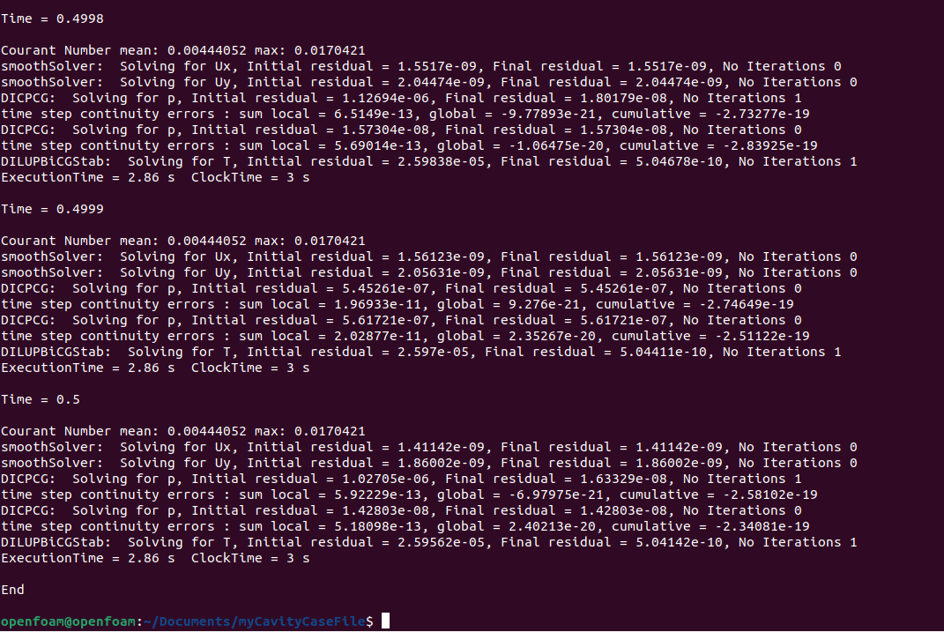
(vi) Run your new case file

Slide 23
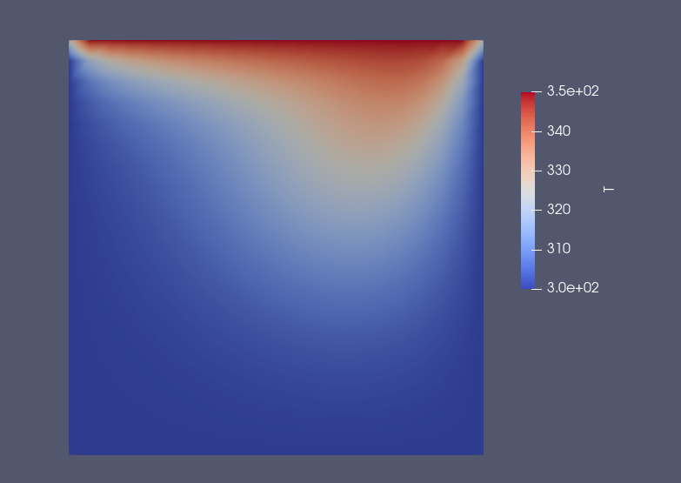
(vii) Upload your new solver, case files, and results in GITHUB

Slide 24
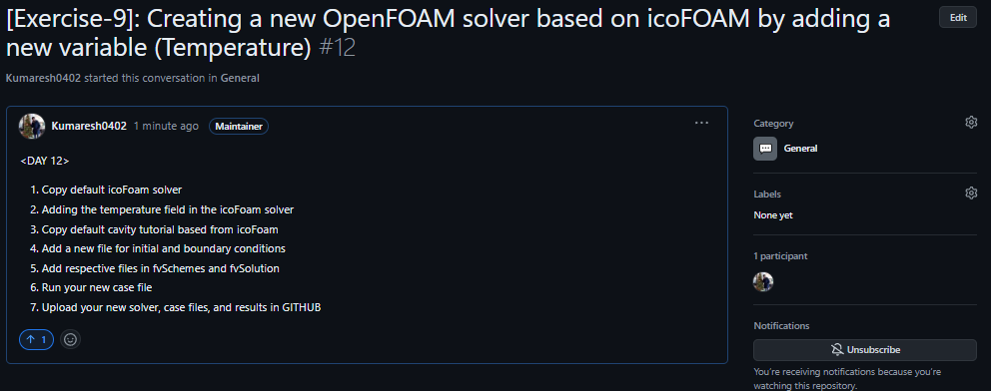
Exercise – 9

